Slide 1
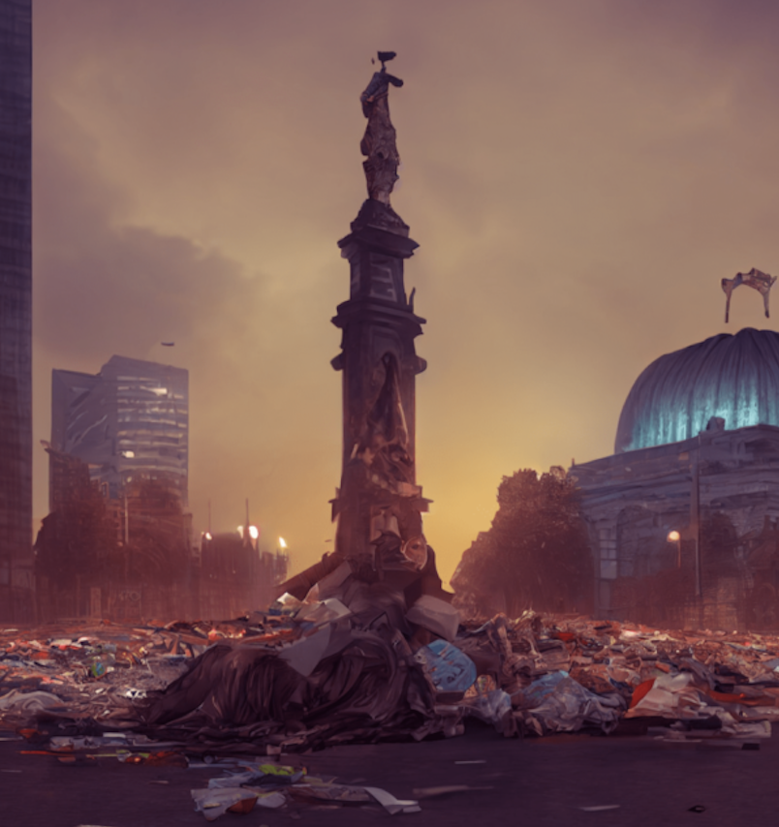

Caption for
QR code above.
rit.edu
Metaverses, Postapocalypses, Vi-fi, Futuropolis, AI, Eco, and Demodystopia in Postpandemic Hispanic-American Literature
Dr. Luis Mora-Ballesteros, author of Ciudades y mundos posibles: Distopías y estados de control en la novela hispanoamericana contemporánea (De Gruyter, 2025) will discuss his recent work on the post-pandemic Hispanic -Aamerican novel. Join us for a presentation followed by an open Q&A.

